Slide 1
FRIEND AFFINITY FINDER “mingo”

Slide 2
Presented by the team: “tricky trackers”
KISHORE.S
KAYALVIZHI.S
S.CHRISTIKA
J.JANAKIRAM

Slide 3

FRIEND AFFINITY FINDER: The active and animated engagement from all strata of society, which has led to explosion in information sharing.

Slide 4









OUR APP CONNECTS

Slide 5

SPECIFICATION:
Feel shy? Don’t worry ,we made it possible to
connect with the people who passes by you.

Slide 6
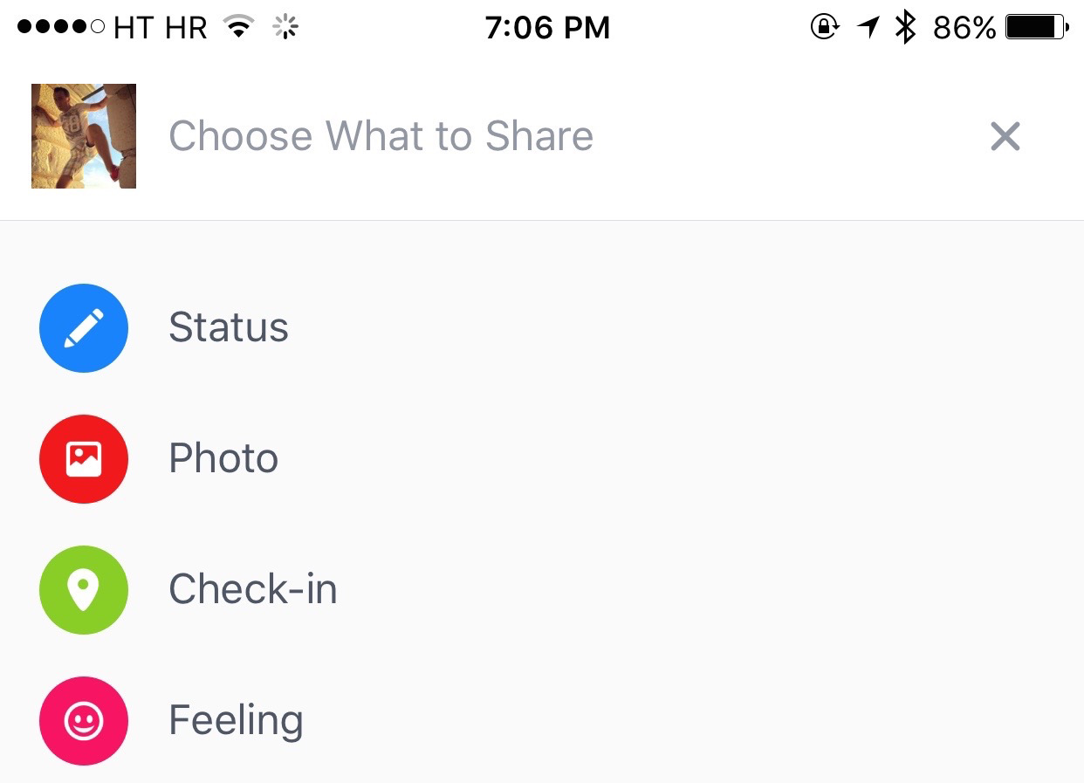
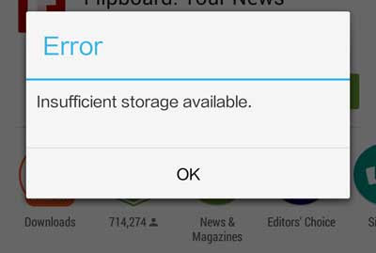
Connect with strangers.
Chat, Upload status, Share your thoughts.
Don’t make your app go disappear due to insufficient space, we provide a tremendous storage capacity with the help of “Firebase“ storage.

Slide 7

We also concentrated on Education By making the user to use our “eChat”.
It is an easy platform to communicate between students and teachers.

Slide 8
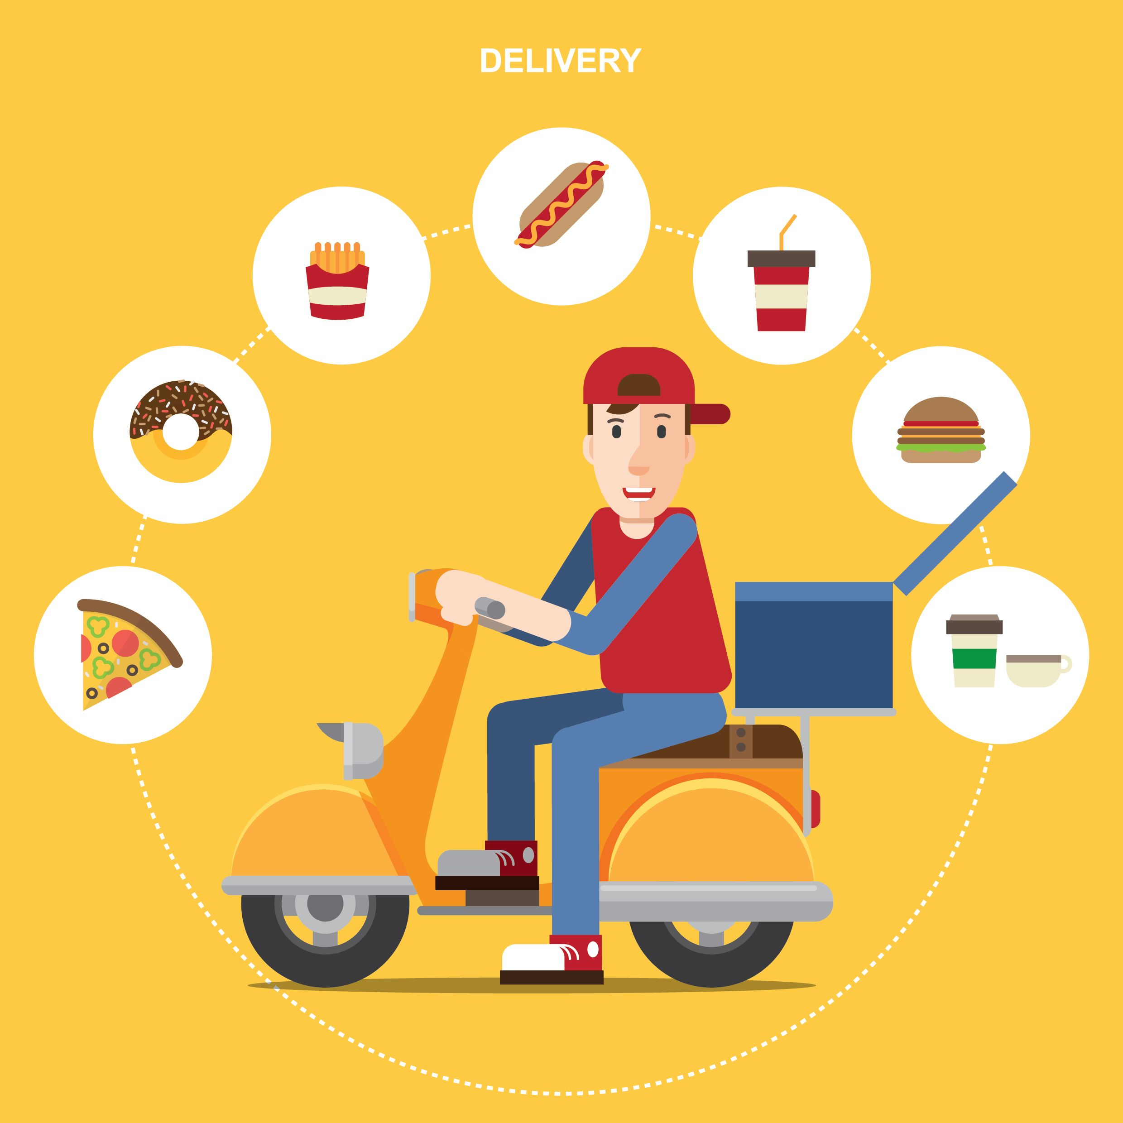
Well ! It is not an end of our application ….
Food icon-YUMMY!!!
- delivers the food on your door step.
Feel so stressed ? Want to relax ? Just book for a movie.
There is an icon of “eTainment” which is provided on Our “MINGO” app.

Slide 9

Ohh!! No one on online?

Slide 10

Don’t worry we have a beautiful chat robot called “Cbot”
You can share your thoughts , feelings , ideas…..With help of our latest AI technology, Cbot responds to your feelings , thoughts in a useful manner.

Slide 11
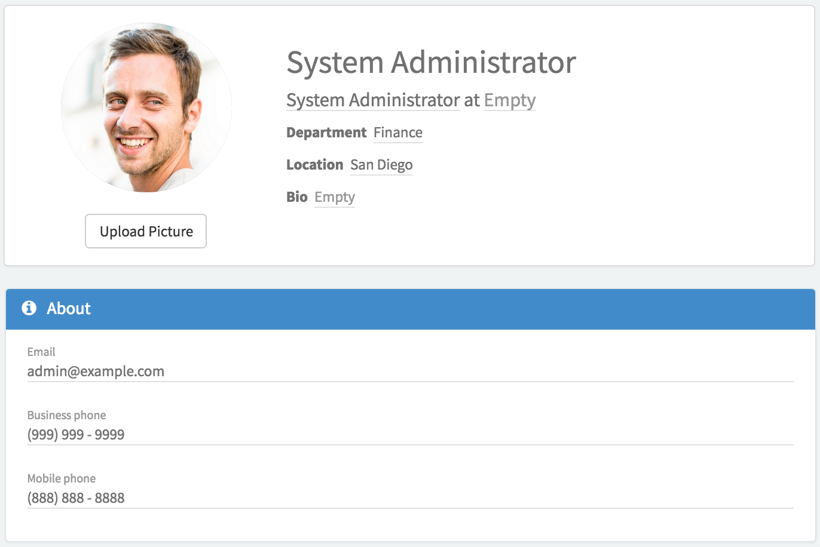
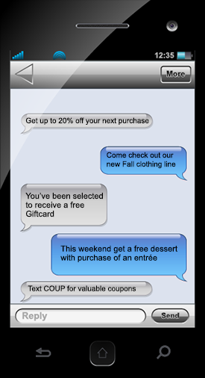
Want to share your status with only your preferred once ? Don’t worry you can make an list of close friends by simply clicking their profile.
We also took care of your privacy in such a way that each messages which the user send will be an end to end encrypted messages.

Slide 12


It has a strong security, in which this app is build with a “three backdoor firewall”.
It also contains an additional facilities such as “Electricity bill payment” and “Currency converter”.

Slide 13

By considering health , we provide health related tips for your day to day activity

Slide 14
THANK YOU

